Slide 1
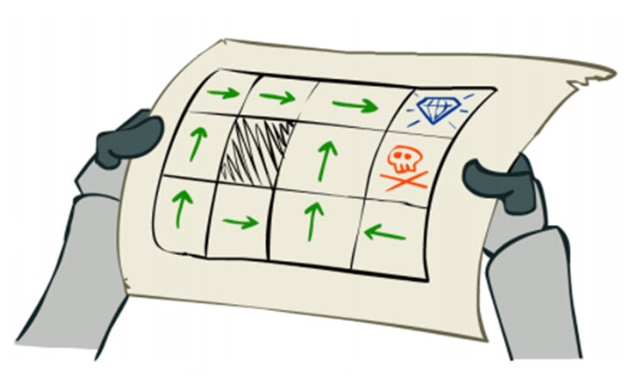
L7.1 Markov Decision Process
Zonghua Gu, Umeå University
Nov. 2023

Slide 2
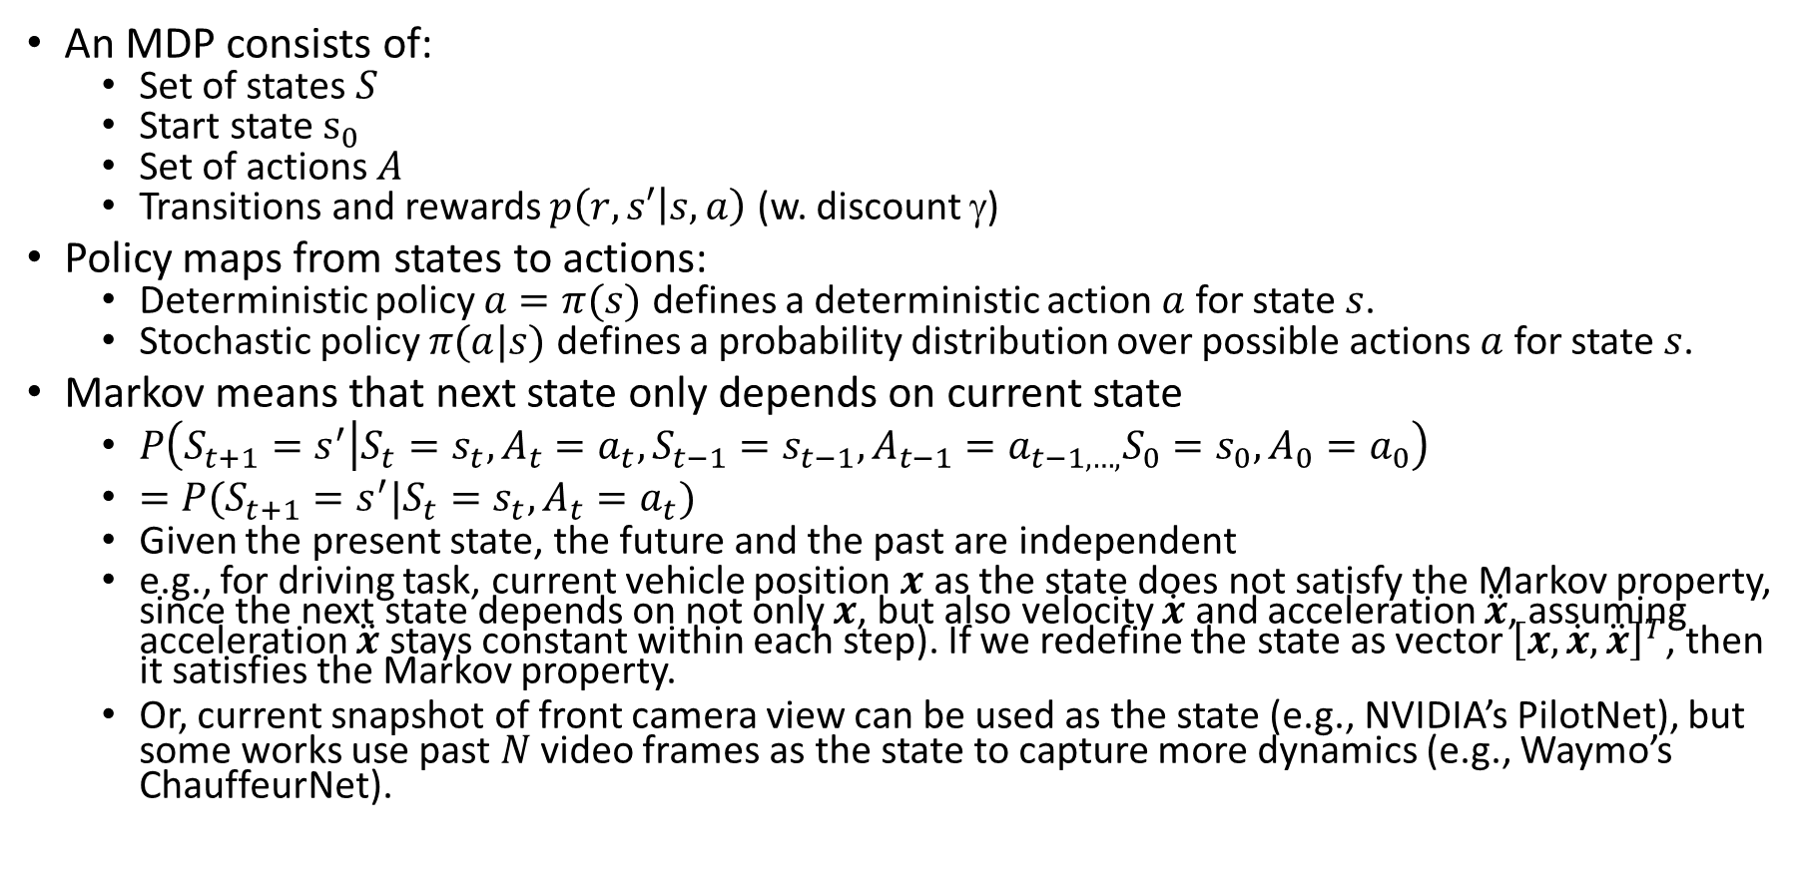
Markov Decision Process (MDP)
An MDP consists of:
Set of states $S$
Start state $s_{0}$
Set of actions $A$
Transitions and rewards $p\left(r,s′ | s,a\right)$ (w. discount $$)
Policy maps from states to actions:
Deterministic policy $a=π(s)$ defines a deterministic action $a$ for state $s$.
Stochastic policy $π(a|s)$ defines a probability distribution over possible actions $a$ for state $s$.
Markov means that next state only depends on current state
$P\left(S_{t+1}=s^{′} | S_{t}=s_{t},A_{t}=a_{t},S_{t−1}=s_{t−1},A_{t−1}=a_{t−1,…,}S_{0}=s_{0},A_{0}=a_{0}\right)$
$=P(S_{t+1}=s^{′}|S_{t}=s_{t},A_{t}=a_{t})$
Given the present state, the future and the past are independent
e.g., for driving task, current vehicle position $x$ as the state does not satisfy the Markov property, since the next state depends on not only $x$, but also velocity $\dot{x}$ and acceleration $\ddot{x}$, assuming acceleration $\ddot{x}$ stays constant within each step). If we redefine the state as vector ${\left[x,\dot{x}, \ddot{x}\right]}^{T}$, then it satisfies the Markov property.
Or, current snapshot of front camera view can be used as the state (e.g., NVIDIA’s PilotNet), but some works use past $N$ video frames as the state to capture more dynamics (e.g., Waymo’s ChauffeurNet).

Slide 3
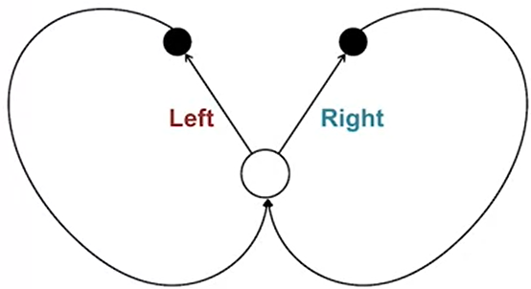
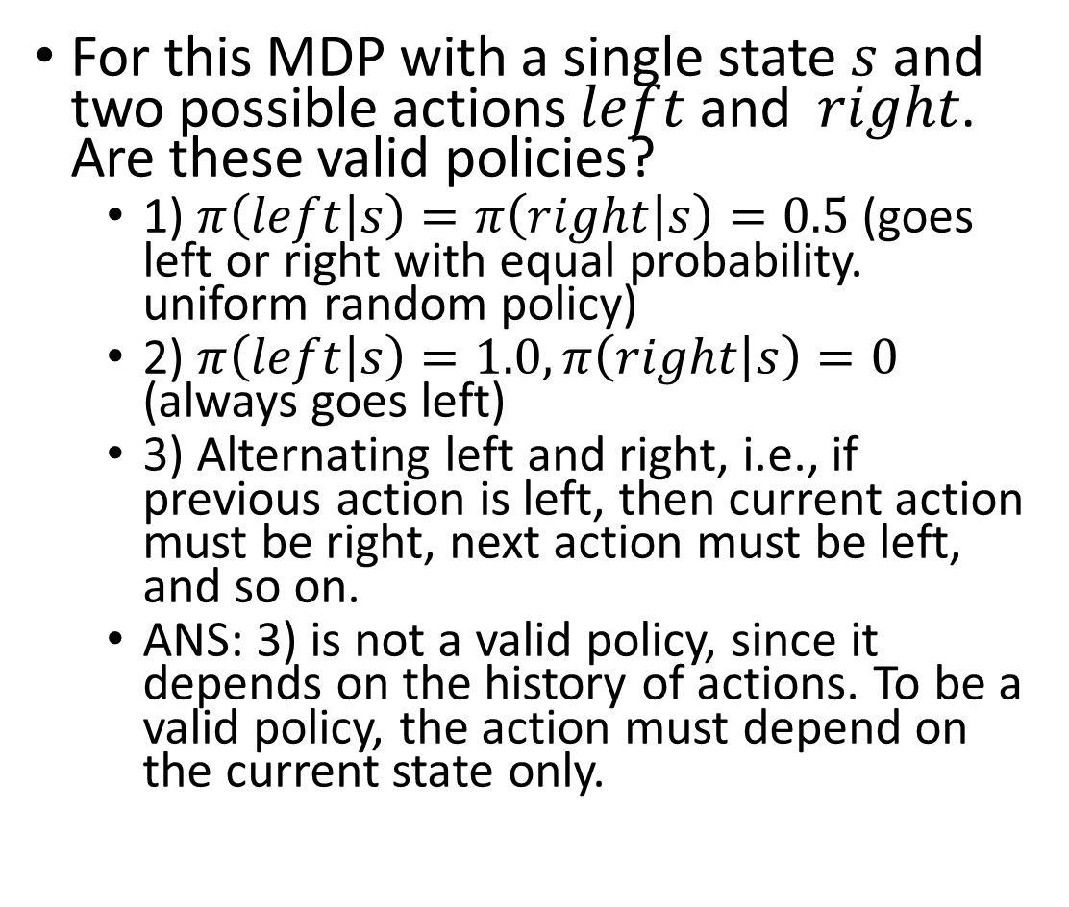



MDP Example 1
For this MDP with a single state $s$ and two possible actions $left$ and $right$. Are these valid policies?
1) $π\left(left | s\right)=π\left(right | s\right)=0.5$ (goes left or right with equal probability. uniform random policy)
2) $π\left(left | s\right)=1.0,π\left(right | s\right)=0$ (always goes left)
3) Alternating left and right, i.e., if previous action is left, then current action must be right, next action must be left, and so on.
ANS: 3) is not a valid policy, since it depends on the history of actions. To be a valid policy, the action must depend on the current state only.
$$(s, left)$$
$$(s, right)$$
$$s$$

Slide 4
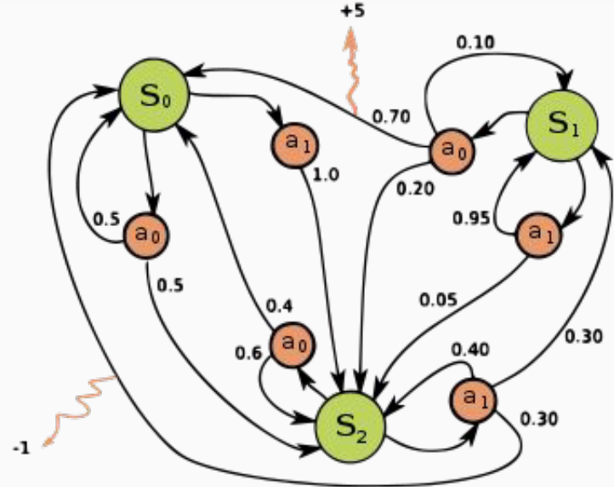
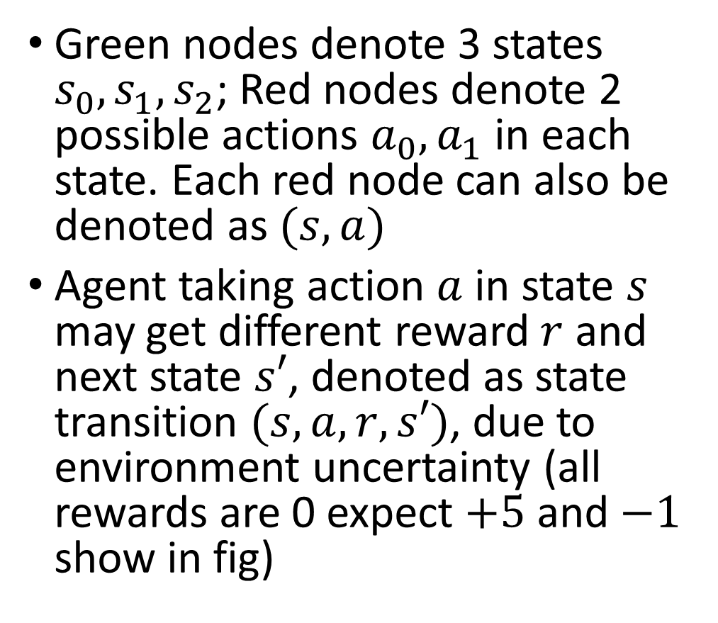
MDP Example 2
Green nodes denote 3 states $s_{0},s_{1},s_{2}$; Red nodes denote 2 possible actions ${a_{0},a}_{1}$ in each state. Each red node can also be denoted as $(s,a)$
Agent taking action $a$ in state $s$ may get different reward $r$ and next state $s′$, denoted as state transition $(s,a,r,s′)$, due to environment uncertainty (all rewards are 0 expect $+5$ and $−1$ show in fig)

Slide 5
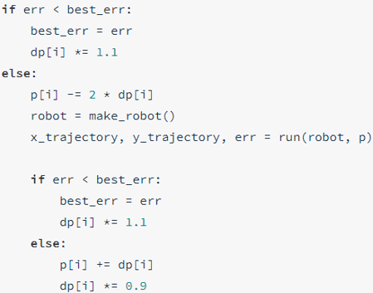
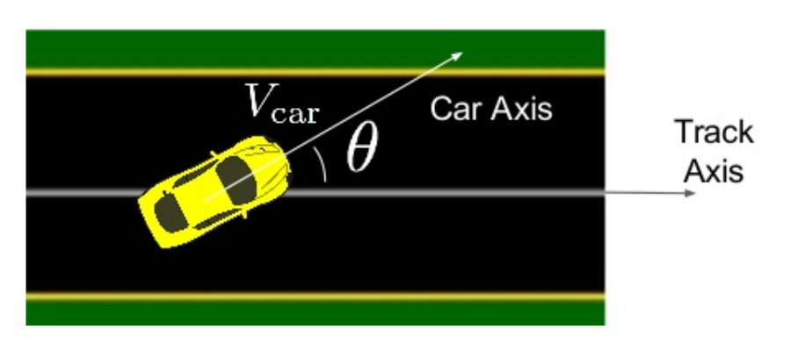
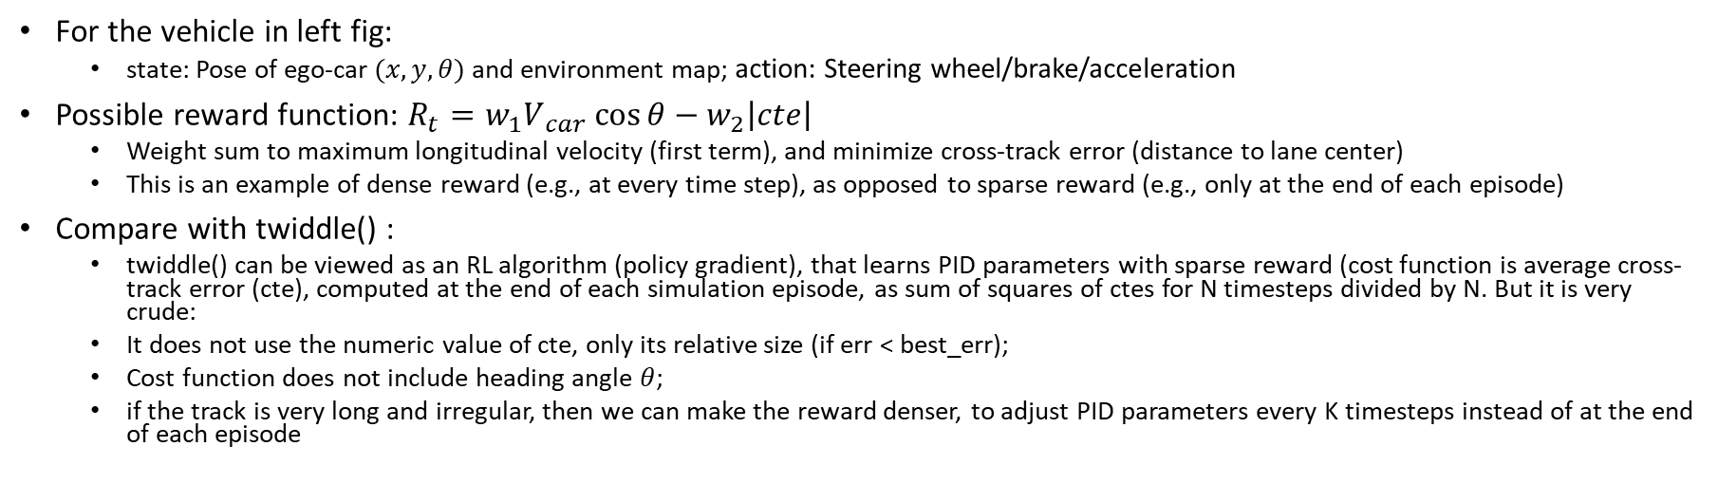
Reward Function
For the vehicle in left fig:
state: Pose of ego-car $(x,y,θ)$ and environment map; action: Steering wheel/brake/acceleration
Possible reward function: $R_{t}​=w_{1}V​_{car}\cos{θ}−​w_{2}\left|cte\right|​$
Weight sum to maximum longitudinal velocity (first term), and minimize cross-track error (distance to lane center)
This is an example of dense reward (e.g., at every time step), as opposed to sparse reward (e.g., only at the end of each episode)
Compare with twiddle() :
twiddle() can be viewed as an RL algorithm (policy gradient), that learns PID parameters with sparse reward (cost function is average cross-track error (cte), computed at the end of each simulation episode, as sum of squares of ctes for N timesteps divided by N. But it is very crude:
It does not use the numeric value of cte, only its relative size (if err < best_err);
Cost function does not include heading angle $θ$;
if the track is very long and irregular, then we can make the reward denser, to adjust PID parameters every K timesteps instead of at the end of each episode
twiddle()
Ben Lau, Quantitative Researcher, Hobbyist, at MLconf NYC 2017

Slide 6
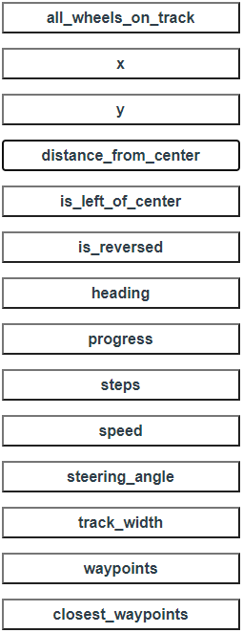
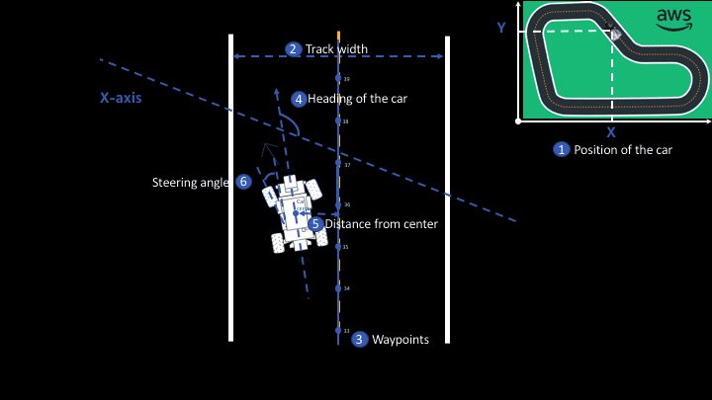
Reward Function in Amazon DeepRacer
Amazon Web Services (AWS) launched DeepRacer in 2018 for training AD algorithms with RL
https://aws.amazon.com/deepracer/
Notes:
You can train RL algorithm in the simulator on AWS cloud, but it costs money after some free time.
They hold competitions, both online and in real-world. 1/10th scale race car costs USD $349.

Slide 7
Example Reward Function
def reward_function(params):
'''Example of penalize steering, which helps mitigate zig-zag behaviors'''
# Read input parameters
distance_from_center = params['distance_from_center']
track_width = params['track_width']
steering = abs(params['steering_angle']) # Only need the absolute steering angle
# Calculate 3 markers that are at varying distances away from the center line
marker_1 = 0.1 * track_width
marker_2 = 0.25 * track_width
marker_3 = 0.5 * track_width
# Give higher reward if the agent is closer to center line and vice versa
if distance_from_center <= marker_1:
reward = 1
elif distance_from_center <= marker_2:
reward = 0.5
elif distance_from_center <= marker_3:
reward = 0.1
else:
reward = 1e-3 # likely crashed/ close to off track
# Steering penalty threshold, change the number based on your action space setting
ABS_STEERING_THRESHOLD = 15
# Penalize reward if the agent is steering too much
if steering > ABS_STEERING_THRESHOLD:
reward *= 0.8
return float(reward)

